Slide 1
Business Requirement
Data Lake:
A multinational company wants to create a central storage repository that will hold big data in raw as well as processed format
Transformations:
Masking and casting to certain columns
Partitions:
Year, Month and Date

Slide 2
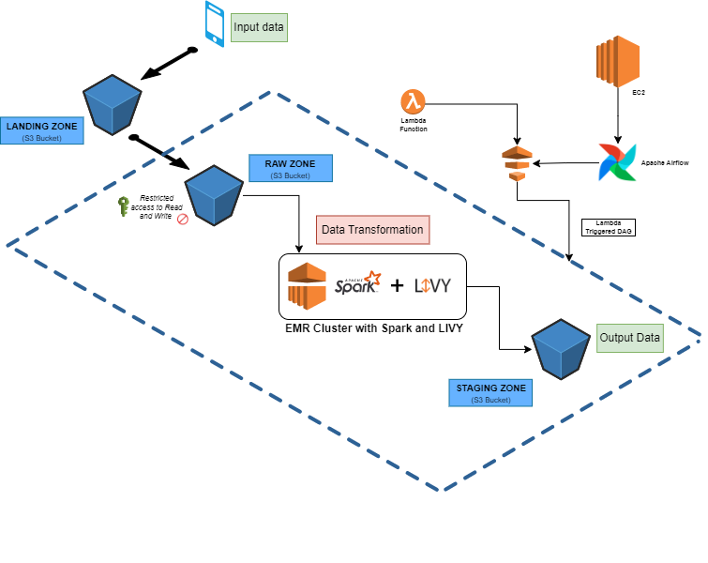
Milestone 1 – Architectural Design

Slide 3
Milestone 2 – Data Lake
Sample Data Preparation using Faker package.
Create S3 buckets for Landing, Raw and Staging zones.
Enable Read/Write policy for the Raw zone.
Enable versioning for all the buckets.
Set Life-cycle rules.

Slide 4
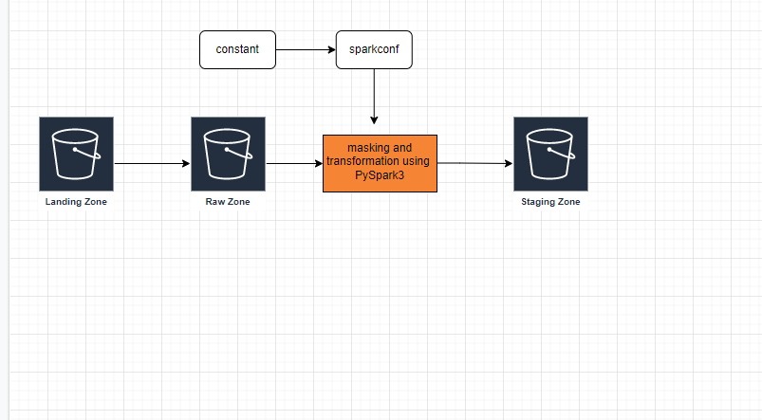
Milestone 3 - EMR Spark Job

Slide 5
Milestone 3 – EMR Spark Job
Step1 : Read constant file.
Step2 : Initialize source and destination bucket url.
Step3 : Copy files from landing zone to raw zone
Step 4 : Apply transformation.
Step 5 : Apply masking.
Step 6 : Apply partition and write into staging zone.

Slide 6
Milestone 4 – Implement with Livy
Interact with Livy and Submit the spark job for easy
Interaction with a spark cluster
Installed the Livy in the EMR cluster
The Default port for Livy in EMR cluster is 8998. There we can
check Livy sessions.
Create a python file to run the Livy.

Slide 7
Milestone 5 - Airflow
Create EC2 instance to install Airflow.
Connect the EC2 instance with Putty
When connecting with Putty, have to create tunneling ports to connect Airflow webserver.
Create a python virtual environment in the EC2 machine.
Install airflow inside of virtual environment.
Create the sample Python file for Hello World DAG.
Run the airflow webserver and scheduler.

Slide 8
Incubation
Thank You
Shibikannan
Rakesh
Nitesh

